Slide 1


Transmission Line Fault Analysis
A MATLAB-Based Simulation for Balanced and Unbalanced Fault Analysis

Slide 2

Introduction to Fault Analysis
Fault analysis is crucial in power systems to ensure reliability and safety. It involves understanding how faults like short circuits affect operations.

Slide 3
01
Fault Analysis

Slide 4
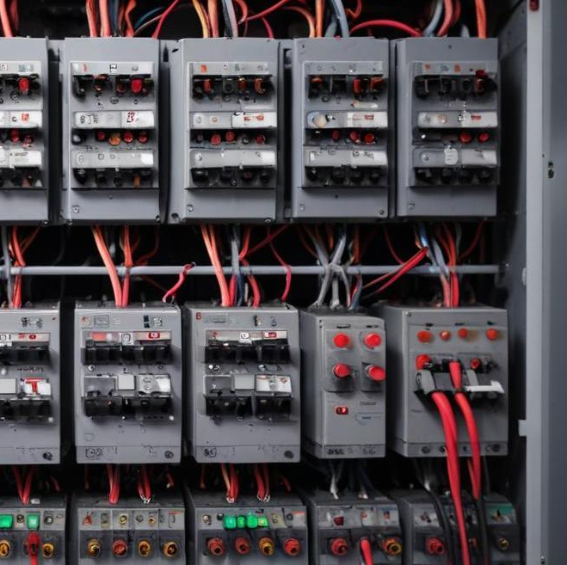
Definition of a fault in power systems
A fault refers to an abnormal condition that disrupts the normal functioning of electrical power systems, such as short circuits, which may lead to equipment damage and instability.

Slide 5
Importance of fault analysis for safety
Fault analysis is vital for protecting equipment from damage, ensuring system reliability, and designing effective protective devices like circuit breakers and relays that mitigate risks during faults.

Slide 6

Types of faults: 1.Balanced 2.Unbalanced
Balanced faults involve all three phases equally, such as three-phase faults.
Unbalanced faults involve one or two phases, like
1.Line-to-ground (LG), 2.Line-to-Line (LL), 3.Double Line-to-Ground (LLG) faults, each affecting system stability differently.

Slide 7
02
Methodology

Slide 8
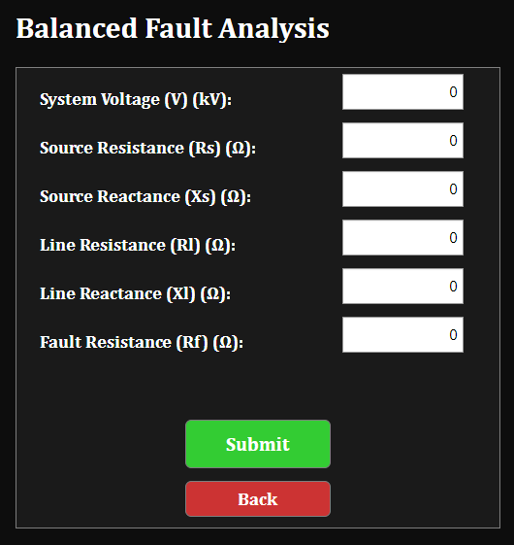
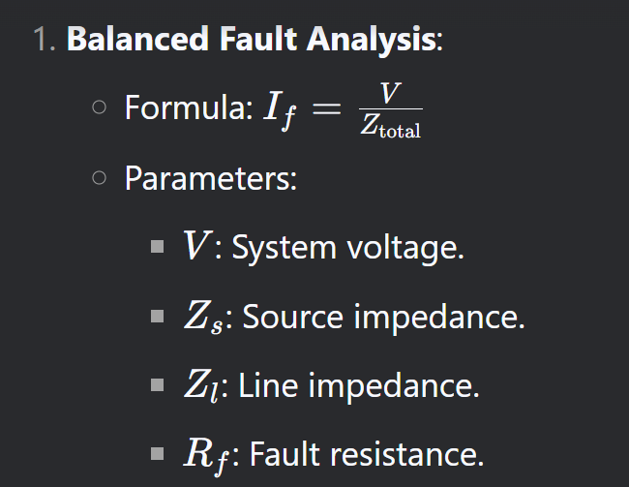
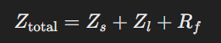
Balanced fault analysis formula and parameters

Slide 9
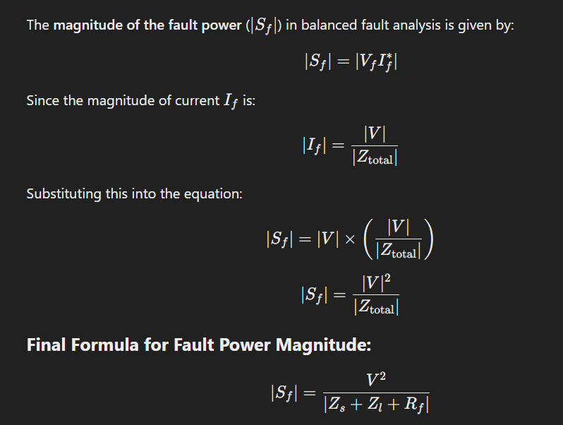
Balanced fault analysis formula and parameters

Slide 10
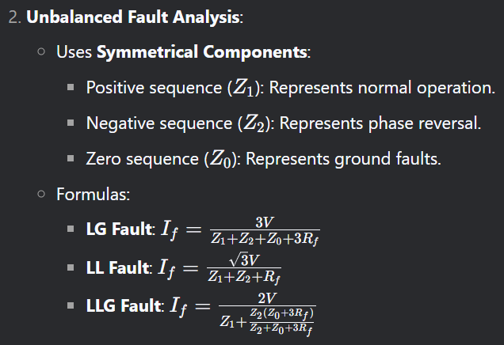
Unbalanced fault analysis using symmetrical components

Slide 11
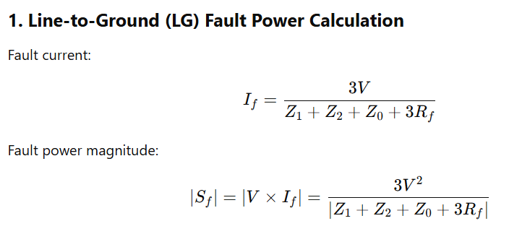
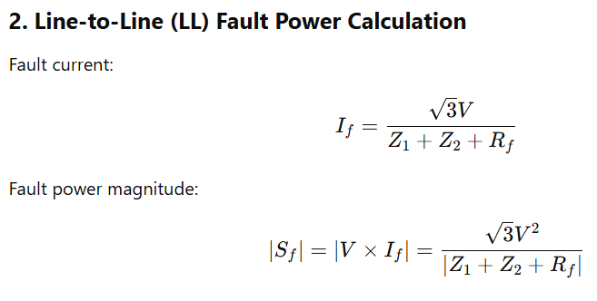
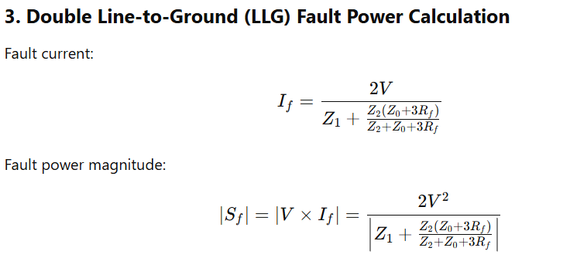
Unbalanced fault analysis using symmetrical components

Slide 12
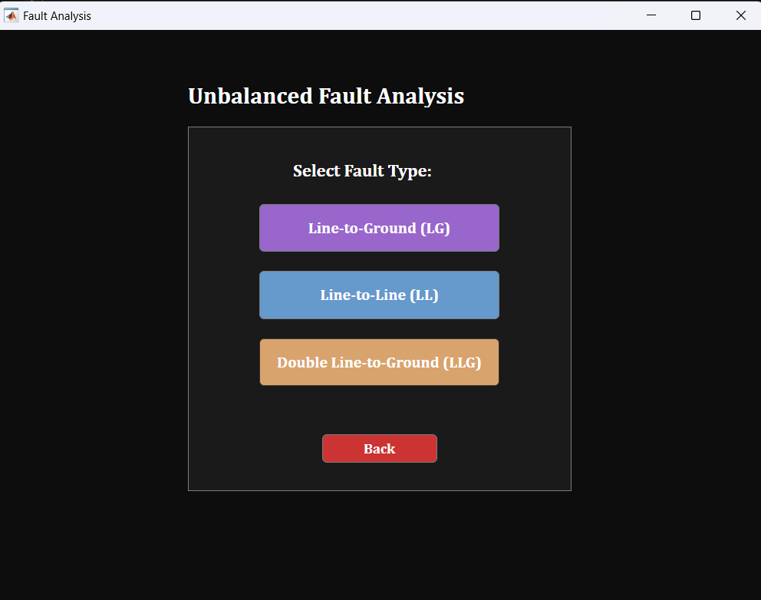
Unbalanced fault analysis

Slide 13
MATLAB implementation for fault simulation
The MATLAB implementation allows users to input system parameters easily. The app calculates fault currents and fault power based on selected fault types and displays results visually via a fault current vs time graph, enhancing the understanding of fault behavior over time.

Slide 14
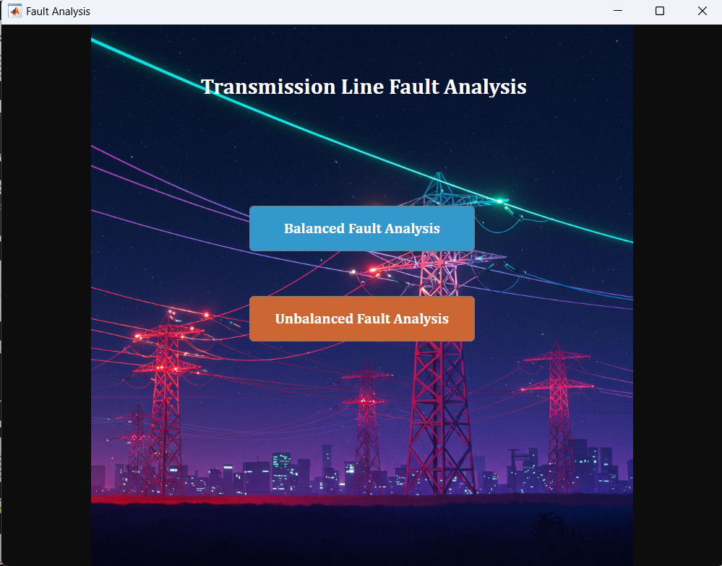

Slide 15
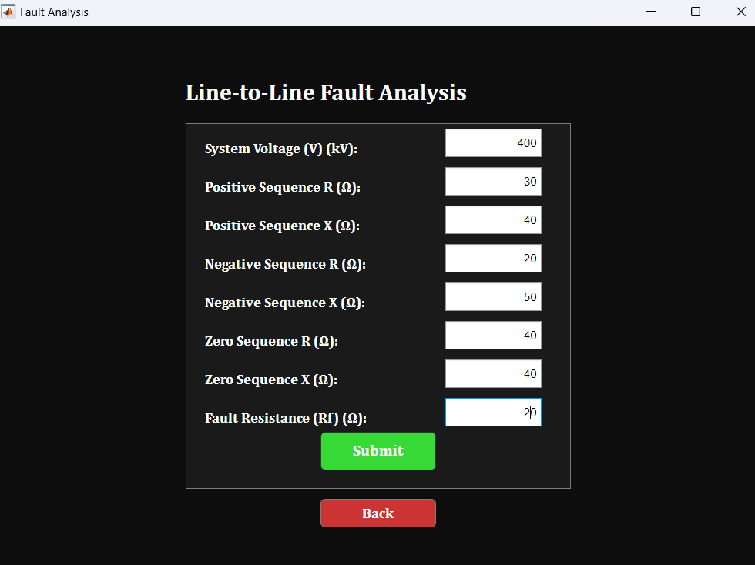

Slide 16
